Slide 1

Shared Preference
Emerging Technology : Flutter
Week 6
Program Studi Teknik Informatika
Fakultas Teknik – Universitas Surabaya

Slide 2

SHARED PREFERENCE
01

Slide 3

Storing Data
Sometimes, we need to store data, either locally (on user’s device) or remotely (e.g. on server)
Simple data (some primitive variables) can be stored on user’s device using platform’s native data storage
Medium data (1—3 tables) may be stored using small database like SQLite
Complex data should be stored on databases

Slide 4
Simple Data Storage
For simple data, you can store it on user’s device. However, native data storage on Android differs from iOS:
On Android, we use Shared Preferences
On iOS, we use NSUserDefaults
How to handle these on Flutter?

Slide 5
Shared Preferences Plugin
The beauty of Flutter: there are plugins available from pub.dev
One plugin is shared_preferences plugin, to alleviate native data storage by wrapping NSUserDefaults on iOS and SharedPreferences on Android into a package, providing a persistent store for simple data.
Supported data types: int, double, bool, String, List<String>
We will use this plugin to store simple data by following steps:
Add the dependency
Save data
Read data
Remove data

Slide 6
Installation and usage
Add the dependency in pubspec.yaml
shared_preferences: ^2.5.3
Storing Data:
For storing data, we can use functions related with its data type:
setInt, setDouble, setString, setBool
// obtain shared preferences
final prefs = await SharedPreferences.getInstance();
// set value
prefs.setInt('counter', counter);

Slide 7
Installation and usage (2)
Read Data
For reading data, we use also functions related with its data type:
getInt, getDouble, getBool, getString
final counter = prefs.getInt('counter') ?? 0;
?? operator will be explained later
Remove Data
For removing data, we use function remove()
prefs.remove('counter');

Slide 8
?? operator (if null)
?? operator works like ?: operator, but it checks the expression for null values:
(if value of this expression is null) ?? (return this value instead)
The previous assignment:
final counter = prefs.getInt('counter') ?? 0;
means: if prefs.getInt('counter') evaluates to null, then assign 0 to counter variable. Otherwise, just read from the shared preferences and assign it to counter variable.

Slide 9
Implementing Shared Preferences
We will implement shared preferences in two places:
Login screen. Shared preference is used for storing the username after user has successfully logged in. It will keep the username until the user logs out.
Therefore, if user never logs in before, or just logged out, the app will display the login screen. If user is already signed in and not logged out yet, every time user opens the app, login screen will be skipped, and the app will display the home screen instead.
Top Score. Shared preference is used to store the username and its score, when user reaches the highest score.

Slide 10
ASYNC
02

Slide 11
Why Asynchronous
Asynchronous operations let your program complete work while waiting for another operation to finish. Here are some common asynchronous operations:
Fetching data over a network.
Writing to a database.
Reading data from a file (shared preference is a kind of file)
To perform asynchronous operations in Dart, you can use the Future class and the async and await keywords.

Slide 12
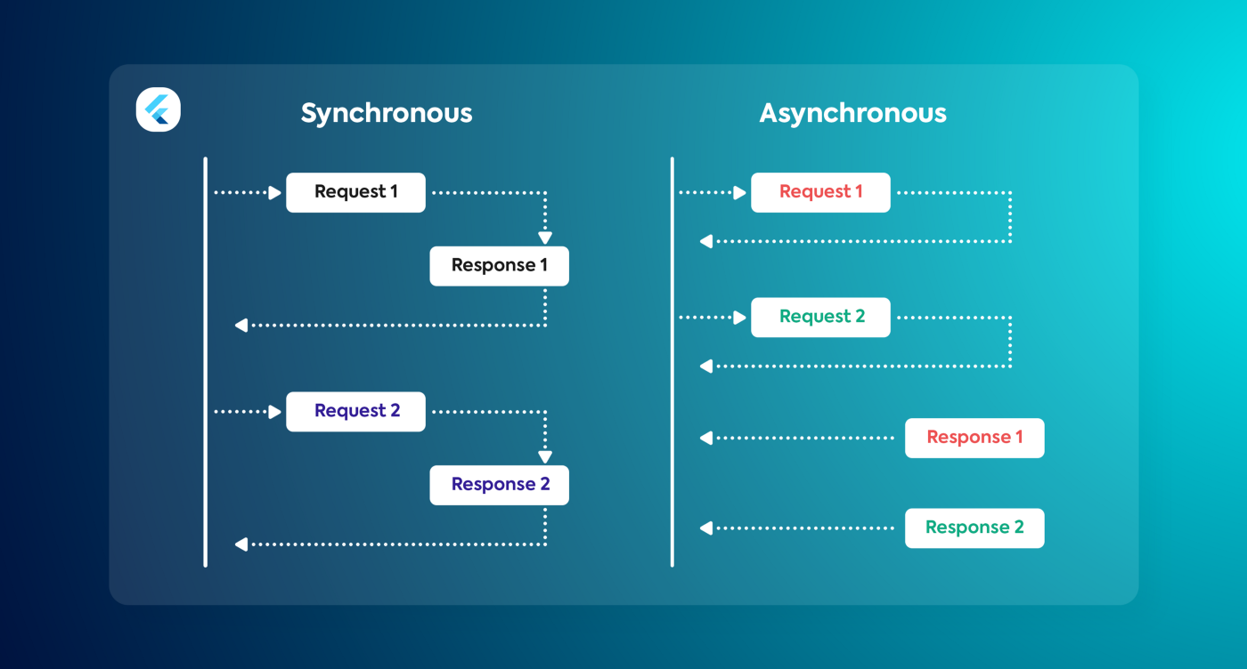
Synchronous vs Asynchronous

Slide 13
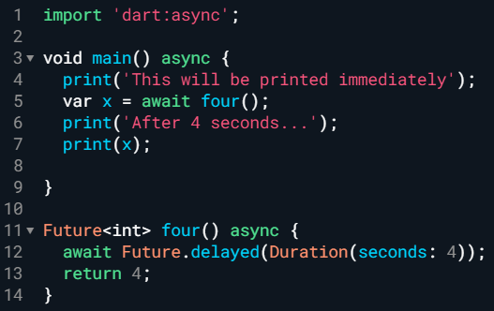
Async and wait
Use async keyword to make a function asynchronous
An async function runs synchronously until the first await keyword
This means that within an async function body, all synchronous code before the first await keyword executes immediately.

Slide 14
Future
A future represents the result of an asynchronous operation
A Future<T> instance produces a value of type T.
If a future doesn’t produce a usable value, then the future’s type is Future<void>.
A future can be in one of two states: uncompleted or completed.
When you call a function that returns a future, the function queues up work to be done and returns an uncompleted future.
When a future’s operation finishes, the future completes with a value or with an error.

Slide 15
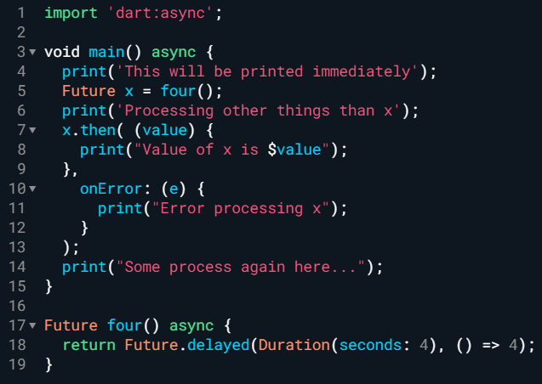
Future and then
then is used for using the future value when the asynchronous process finishes.

Slide 16
LOGIN
03

Slide 17
Login screen
We will prepare a new screen for the login form. It uses stateful type and has structure like myApp. Add these codes on main.dart (or, if you want to tidy up your code, create a new file, login.dart)
import 'package:flutter/material.dart';
class MyLogin extends StatelessWidget {
@override
Widget build(BuildContext context) {
return MaterialApp(
title: 'Flutter Demo',
theme: ThemeData(
primarySwatch: Colors.blue,
),
home: Login(),
);
}
}
class Login extends StatefulWidget {
@override
State<StatefulWidget> createState() {
return _LoginState();
}
}
class _LoginState extends State<Login> {
@override
Widget build(BuildContext context) {
return Scaffold(
appBar: AppBar(
title: Text('Login'),
),
body: Container(
height: 300,
margin: EdgeInsets.all(20),
padding: EdgeInsets.all(20),
decoration: BoxDecoration(
borderRadius: BorderRadius.all(Radius.circular(10)),
border: Border.all(width: 1),
color: Colors.white,
boxShadow: [BoxShadow(blurRadius: 5)]),
child: Column(children: [
]),
));
}
}
Next slide inserted here

Slide 18
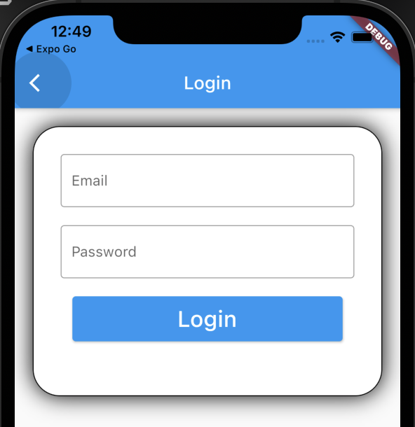
Login screen (2)
Padding(
padding: EdgeInsets.all(10),
child: TextField(
decoration: InputDecoration(
border: OutlineInputBorder(),
labelText: 'Email',
hintText: 'Enter valid email id as abc@gmail.com'),
),
),
Padding(
padding: EdgeInsets.all(10),
//padding: EdgeInsets.symmetric(horizontal: 15),
child: TextField(
obscureText: true,
decoration: InputDecoration(
border: OutlineInputBorder(),
labelText: 'Password',
hintText: 'Enter secure password'),
),
),
Padding(
padding: EdgeInsets.all(10),
child: Container(
height: 50,
width: 300,
decoration: BoxDecoration(
borderRadius: BorderRadius.circular(20)),
child: ElevatedButton(
onPressed: () {},
child: Text(
'Login',
style: TextStyle(fontSize: 25),
),
),
)),

Slide 19
Check User ID
Add checking of shared preference user_id.
dependencies:
shared_preferences: ^2.5.3
add import (in main.dart):
import 'package:shared_preferences/shared_preferences.dart';
add global variable (in main.dart):
String active_user = "";
add function to check user (in main.dart)
Future<String> checkUser() async {
final prefs = await SharedPreferences.getInstance();
String user_id = prefs.getString("user_id") ?? '';
return user_id;
}
Replace runApp(myApp());
on void main with:
WidgetsFlutterBinding.ensureInitialized();
checkUser().then((String result) {
if (result == '')
runApp(MyLogin());
else {
active_user = result;
runApp(MyApp());
}
});

Slide 20
Do Login
Since we have not yet learnt about database, and in order to focus on the shared preference, this time we will not check anything about username and its password. Whatever user inputs in the user name and password field, we will accept it. The user name will be stored in shared preferences and screen is changed to the main screen.
Prepare a variable that stores the value of Username textfield.
Then create function to store it in shared preference. Call this function upon clicking the Login button
void doLogin() async {
//later, we use web service here to check the user id and password
final prefs = await SharedPreferences.getInstance();
prefs.setString("user_id", active_user);
main();
}
onChanged: (v) {
active_user = v;
},
You need to use this import:
import 'package:helloworld/main.dart’;
to gain access to main()

Slide 21
Test
Do a login
Restart the app.
  Do you get a login screen or directly to main screen? Why?
Can you replace the xyz name in the drawer with the active_user name?
How to get the login screen again ?
Hints:
Use following command to make flutter run on “fix” port number. This is useful to prevent the browser treat the website differently each runs -> TLDR: to make user login state works!
flutter run -d chrome --web-browser-flag "--disable-web-security" --web-port 1234

Slide 22
Solutions
In main.dart (_MyHomePageState class)
@override
void initState() {
super.initState();
checkUser().then((value) => setState(
() {
active_user = value;
},
));
}
In the drawer
children: <Widget>[
UserAccountsDrawerHeader(
accountName: Text("xyz"),
accountEmail: Text(active_user),

Slide 23
LOGOUT
04

Slide 24
Logout
We can get our login screen again if we log out from the app. Prepare the logout menu and remove the Shared Preference user_id when this menu is clicked. Write this within main.dart (class _MyHomePageState).
Make sure you provide the logout menu inside the drawer. And within the onTap, called the doLogout()

Slide 25
EXERCISE
05

Slide 26
Top Score
When your quiz is finished :
Check the shared preference top_point, if null or less than user point, save the shared preference top_point with user point, and top_user with active_user.
Create a screen (highscore.dart) that show the top_user and top_point.

Slide 27



